Slide 1

RECRUITING, RETENTION, MARKETING

Slide 2

SC DEPT. MARINE CORPS LEAGUE
Executive Summary: The Grassroots Mandate
CORE STRATEGIC IMPERATIVE
Growth does not happen at the Department or National level—it happens locally at the Detachment. Effective recruiting, retention, and marketing must be executed where Marines live, work, and interact in their communities.
Recruiting
Driven by personal outreach and active community visibility rather than passive waiting.
Retention
Achieved through immediate 90-day onboarding, purpose-driven roles, and strong camaraderie.
Marketing
Hyper-local campaigns tailored to county-level veteran demographics and local media.

Slide 3
SC DEPT. MARINE CORPS LEAGUE
Why Strategy Must Live at the Lowest Level
Marines Join Marines, Not Headquarters
Veterans connect with local members they see, respect, and interact with in their own towns.
100%
LOCAL EXECUTION
Department provides guidance and tools, but individual Detachments build the relationships that win members.
Community Trust is Built Locally
Presence at local VFWs, American Legions, gun shows, and parades creates trust.
Grassroots Adaptability
A strategy for Charleston/Parris Island differs from rural Upstate detachments. Local leadership knows their terrain best
Direct Accountability
When detachment members own the recruiting goal, retention and engagement naturally follow.

Slide 4
SC DEPT. MARINE CORPS LEAGUE
The 3 Strategic Pillars of Detachment Growth
Pillar 1: Recruiting
Active Local Pipeline
• Community Presence & Booths
• Transitioning Marine Outreach
• Sponsor-a-Marine Initiative
• Word-of-Mouth Campaigns
Pillar 2: Retention
Member-Centric Engagement
• 90-Day Onboarding Protocol
• Purpose-Driven Roles & Duty
• Active Peer Mentorship
• Family-Inclusive Events
Pillar 3: Marketing
Hyper-Local Visibility
• County-Level Media & Radio
• Targeted Social Media Ads
• Civic Partnership Outlets
• Local Event Sponsorships

Slide 5
SC DEPT. MARINE CORPS LEAGUE
Pillar 1: Building a Local Recruiting Pipeline
1. Community Presence
Set up informational tables at gun shows, farmers markets, high school games, and local festivals.
1
2. First Contact
Collect contact information immediately via mobile form or paper card. Never rely on verbal interest.
2
3. 48-Hour Follow-Up
Detachment Recruiting Officer calls/texts prospect within 48 hours to invite them as a guest.
3
4. Sponsor Orientation
Assign an active member as a personal sponsor for their first 3 detachment meetings.
4

Slide 6
SC DEPT. MARINE CORPS LEAGUE
Evolving Recruitment Tactics: Passive vs. Active
PASSIVE APPROACH (OLD)
❌ Waiting for walk-ins at monthly meetings
❌ Relying solely on word-of-mouth
❌ Generic brochures with no local contact
❌ Infrequent presence at veteran events
❌ Focusing only on retired Marines
ACTIVE APPROACH (NEW)
✔ Proactive outreach at community venues
✔ Structured 'Sponsor a Marine' referral drive
✔ Customized flyers with Detachment Officer cell #
✔ Monthly booth presence across county events
✔ Targeting transitioning Marines & active reserves

Slide 7
SC DEPT. MARINE CORPS LEAGUE
Attracting Younger & Transitioning Marines
MCAS Beaufort & MCRD Parris Island Proximity
Establish direct liaisons with TAP (Transition Assistance Program) offices and local Marine Reserve units in South Carolina.
Career & Professional Networking
Position the League as a mentorship bridge offering local business leads, resume advice, and civilian integration support.
Family-Inclusive Activity Focus
Younger veterans have families; host weekend cookouts, service projects, and family outings rather than late-night bar meetings.
Digital-First Communication
Use Signal, WhatsApp, and social groups for fast coordination instead of long email chains or monthly-only contact.

Slide 8
SC DEPT. MARINE CORPS LEAGUE
Pillar 2: Retention Starts Day One
Day 1 - 7
Day 30
Day 90
Welcome & Sponsor
Welcome phone call from Commandant. Assign dedicated Sponsor. Send welcome packet with meeting details.
Purpose & Assignment
Identify member's skills/interests. Assign a meaningful role (color guard, event team, web, youth programs).
Check-In & Feedback
Formal sponsor check-in. Evaluate engagement level and ensure member feels valued and included.

Slide 9
SC DEPT. MARINE CORPS LEAGUE
Purpose-Driven Retention & Engagement
Local Community Impact
Marines stay when they have a mission. Engage in Toys for Tots, local color guards, veteran assistance, and youth programs.
Camaraderie Beyond Business Meetings
Ensure meetings are concise (under 1 hour) and followed by social time, food, and genuine fellowship.
Recognition & Valued Contributions
Recognize member milestones, volunteer hours, and achievements publicly at every detachment meeting.
Modern Communication Channels
Respect members' time. Use text/email summaries for those unable to attend every physical meeting.

Slide 10
SC DEPT. MARINE CORPS LEAGUE
Pillar 3: Hyper-Local Marketing Strategy
County & City Community Outlets
Distribute press releases and event notices to local newspapers, community bulletin boards, and radio stations.
High-Visibility Civic Partnerships
Partner with local police, fire departments, high school JROTC units, and civic organizations for joint events.
Targeted Event Marketing
Promote Marine Corps Birthday Balls, parades, and fundraisers across local community calendars.

Slide 11
SC DEPT. MARINE CORPS LEAGUE
Digital Presence: Public Outreach vs. Internal Chat
PUBLIC FACE (FACEBOOK / WEBSITE)
• Clean, updated Detachment Facebook page
• Post photos of community service & events
• Clear meeting location, date & contact info
• Fast response to direct messages from prospects
• Google Maps listing for Detachment meeting hall
INTERNAL ENGAGEMENT (GROUPS)
• Private Facebook Group or GroupMe for members
• Real-time event updates and volunteer signups
• Peer support, wellness checks, and news
• Informal photo sharing and camaraderie
• Immediate broadcast of urgent member needs

Slide 12
SC DEPT. MARINE CORPS LEAGUE
Division of Responsibility: Department vs. Detachment
AREA | DEPARTMENT ROLE (SUPPORT) | DETACHMENT ROLE (EXECUTION)
Recruiting | Provides marketing templates, banners & state guides | Executes local outreach, mans booths, contacts leads
Retention | Tracks statewide membership metrics & awards | Runs 90-day onboarding, assigns sponsors & duties
Marketing | Maintains state website | Manages local FB page, places local ads, press releases
Leadership | Conducts officer training | Appoints recruiting officer, engages local community

Slide 13
SC DEPT. MARINE CORPS LEAGUE
The Detachment Recruiting & Marketing Toolkit
Customizable Local Flyer
Fillable PDF flyer with Detachment name, meeting location, date, and recruiting officer phone/email.
Digital Lead Form
QR code linking directly to a simple online interest form for instant lead capture at events.
Sponsor Guidance Checklist
1-page guide for detachment sponsors outlining contact milestones for new members.
Press Release Template
Ready-to-use news releases for local media announcing meetings, events, and community projects.

Slide 14
SC DEPT. MARINE CORPS LEAGUE
KPIs & Detachment-Level Accountability
Net Membership Growth
Target: +10% net membership growth per detachment annually.
First-Year Retention Rate
Target: 85%+ retention rate of new members brought in over the last 12 months.
Outreach Events Held
Target: Minimum 4 active community recruiting events per detachment per year.
48-Hour Lead Response
Target: 100% of prospective member leads contacted within 48 hours.

Slide 15
CONCLUSION & CALL TO ACTION
The Future of the League Lies in Our Detachments
✔ Empower local Detachment Officers with toolkits, templates, and clear goals.
✔ Shift focus from passive waiting to proactive grassroots community engagement.
✔ Prioritize 90-day retention to keep every Marine engaged and purpose-driven.
✔ Execute hyper-local marketing to ensure every Marine in South Carolina knows our mission.
Semper Fidelis!

Slide 16
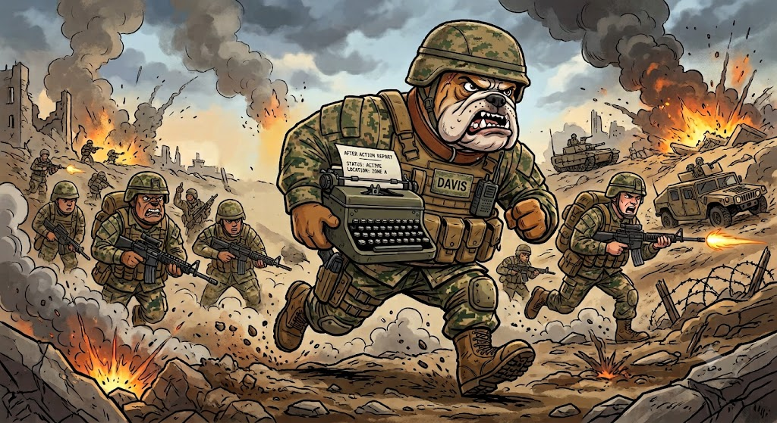
QUESTIONS??

